Slide 1

Diamond deals
Unraveling the Metrics and Money in MLB Player Transactions
Hayden Ravert
Woz U

Slide 2
Background
Hayden Ravert
B.S. Astrophysics From Towson University
10 years of Retail Management
A lifetime of watching and analyzing Baseball

Slide 3
Project Question
What is the financial value of free agent players in Major League Baseball?

Slide 4
Determining A Players Value
Players Position
Pitcher vs. Position Player?
Player Statistics
Which statistics should we use?
Statistics vs. Salary
How do the stats influence salary?

Slide 5
Pitcher
Stats
ERA – Earned Run Average
Number of Runs per nine innings (Lower Better)
WHIP – Walks and Hits per Inning
How well a pitcher keeps players off base (Lower Better)
-IP – Innings Pitched
Number of innings pitched over a season (Higher Better)
-W – Wins
Pitcher of record with a lead after five innings when starting or most effective relief pitcher (Higher Better)
-SV – Saves
Pitcher who gets the last three outs with a lead of no more that three runs (Higher Better)

Slide 6
Position Players
Stats
H – Hits
When a player hits the ball in fair territory and reaches base (Higher Better)
RBI – Runs Batted In
When a player's plate appearance results in a run scored (Higher Better)
HR – Home Runs
When a player scores who hit the ball in fair territory (Higher Better)
AVG – Batting Average
Total Hits divided by Total At Bats (Higher Better)
OPS – On Base Percentage Plus Slugging
How well a hitter can reach base and how well he can hit for average and power (Higher Better)

Slide 7
WAR
Wins Above Replacement
Measures a player’s win value versus a replacement player at the same position(usually a Minor League replacement) (Higher Better)
WAR = (Batting Runs + Base Running Runs +Fielding Runs + Positional Adjustment + League Adjustment +Replacement Runs) / (Runs Per Win)
WAR = [[([(League “FIP” – “FIP”) / Pitcher Specific Runs Per Win] + Replacement Level) * (IP/9)] * Leverage Multiplier for Relievers] + League Correction

Slide 8
Gathering Data Methods
All data from spotrac.com
Free Agent Signings of seasons 2019-2023
Player, Position, Age, Bats, Throws, Team From, Team To, Years Signed, Total Salary, Average Yearly Salary
Stats of players from seasons 2018-2022
H, RBI, HR, AVG, OPS, IP, ERA, WHIP, W, SV, WAR
Starting with 679 Samples

Slide 9
Manipulating Data
Add Player Id column
Split the data into Pitcher and Position Player
Created dummy variables to match positions to separate
Drop irrelevant columns
Position, Bats, Throws, From, To
Drop missing values or change to 0
Pitchers
Age, Average Salary, Innings Pitched, ERA, WHIP, Wins, Saves, WAR
Sample Size 331
Position Players
Age, Average Salary, Hits, RBI, HR, AVG, OPS, WAR
Sample Size 278

Slide 10
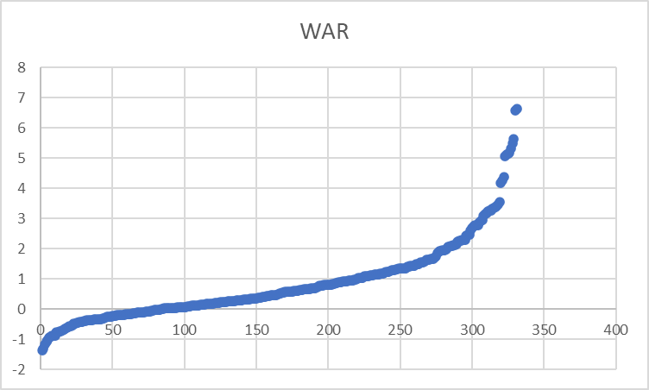
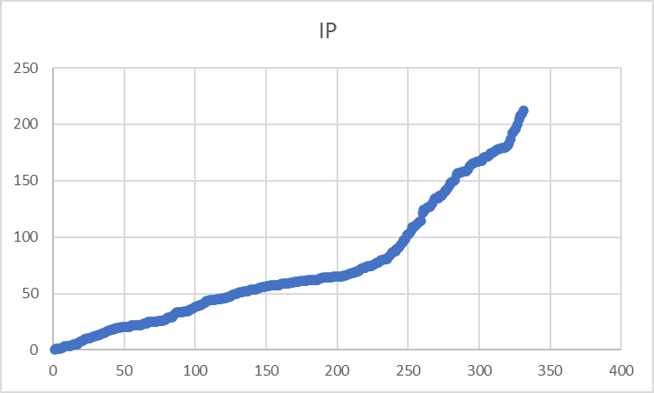
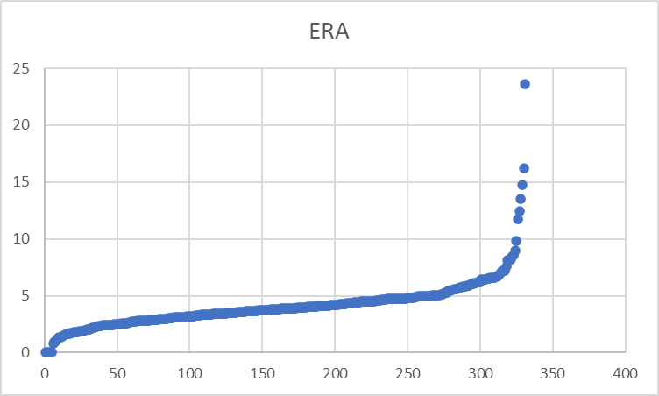
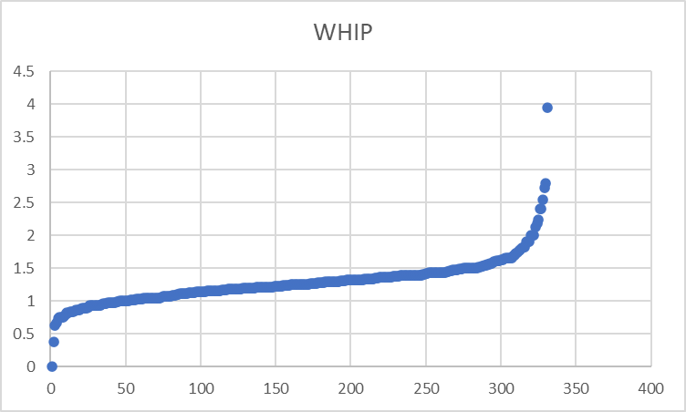
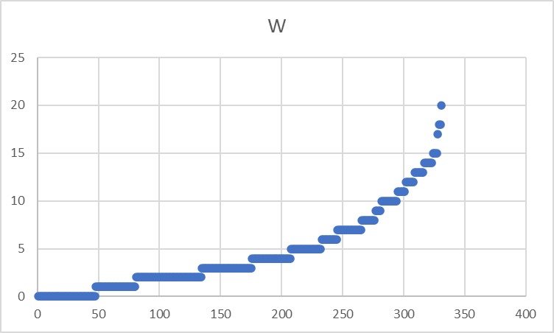
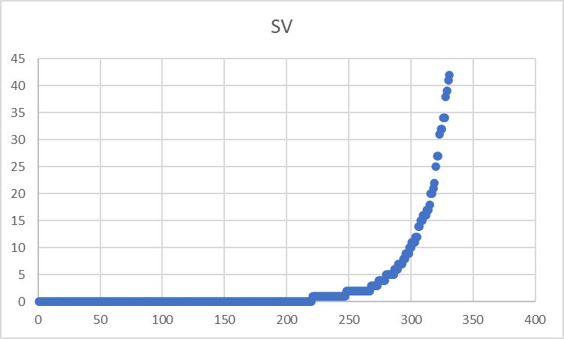
Pitcher Data Exploration

Slide 11
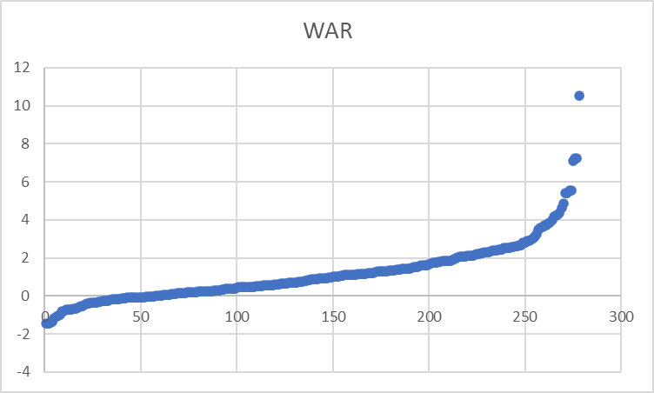
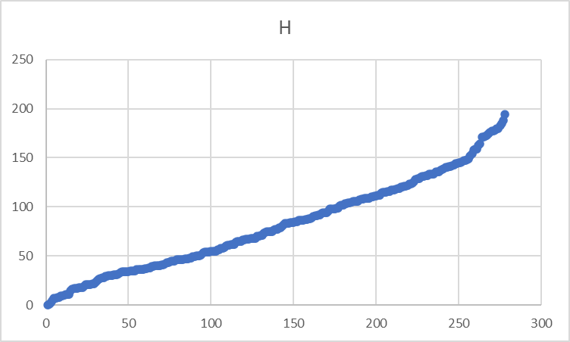
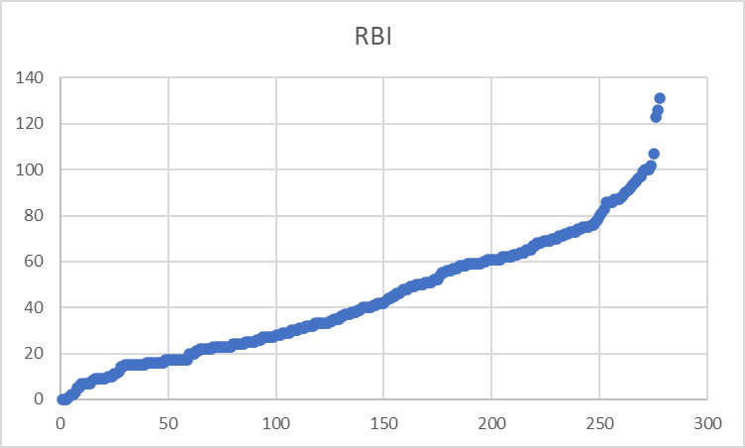
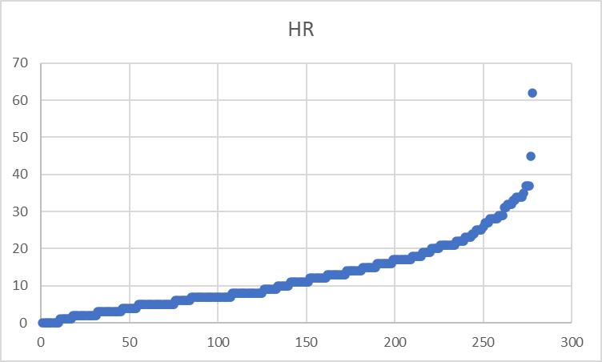
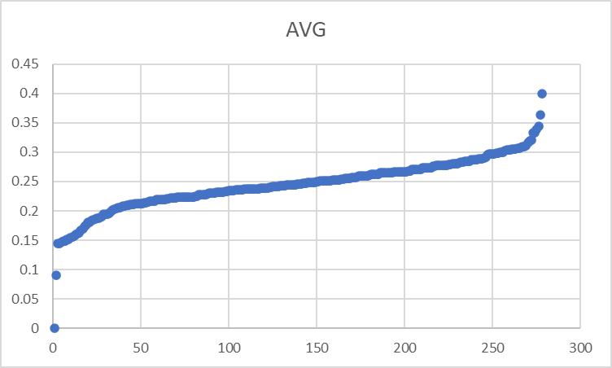
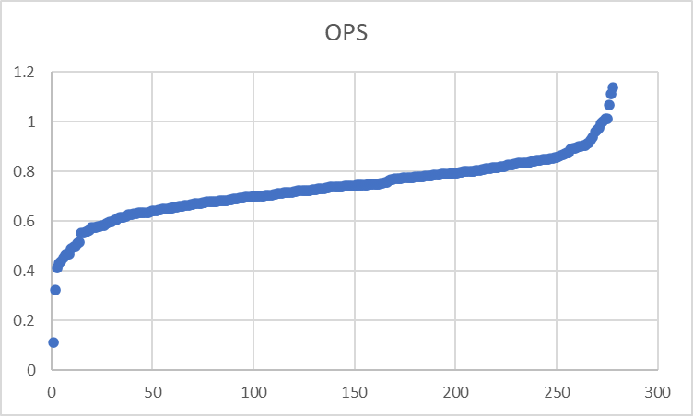
Position Player Data Exploration

Slide 12
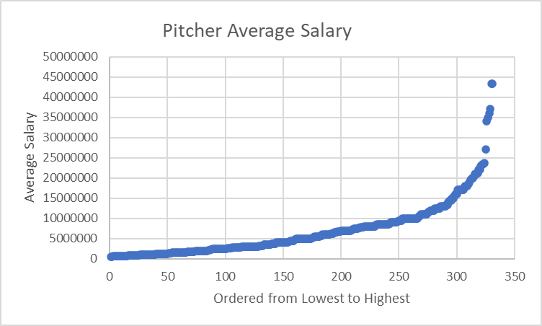
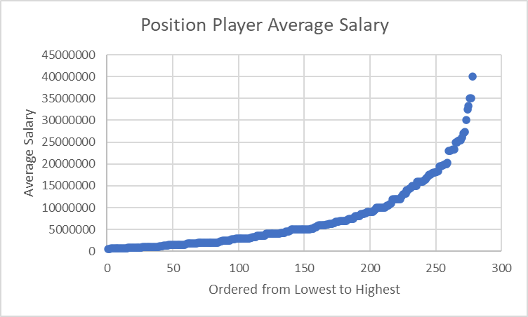
Salary Data Exploration

Slide 13
Result Analysis Methods
Stepwise Exponential Regression
Method used to model the relationship between a dependent variable and one or more independent variables that adds or removes predictor variables from the model in a step-by-step fashion.
Mediation
Analysis used to explore the indirect effect of an independent variable on a dependent variable through a variable with a causal relationship.
Moderation
Analysis that examines the influence of a third variable on the strength or direction of the relationship between an independent variable and a dependent variable.

Slide 14
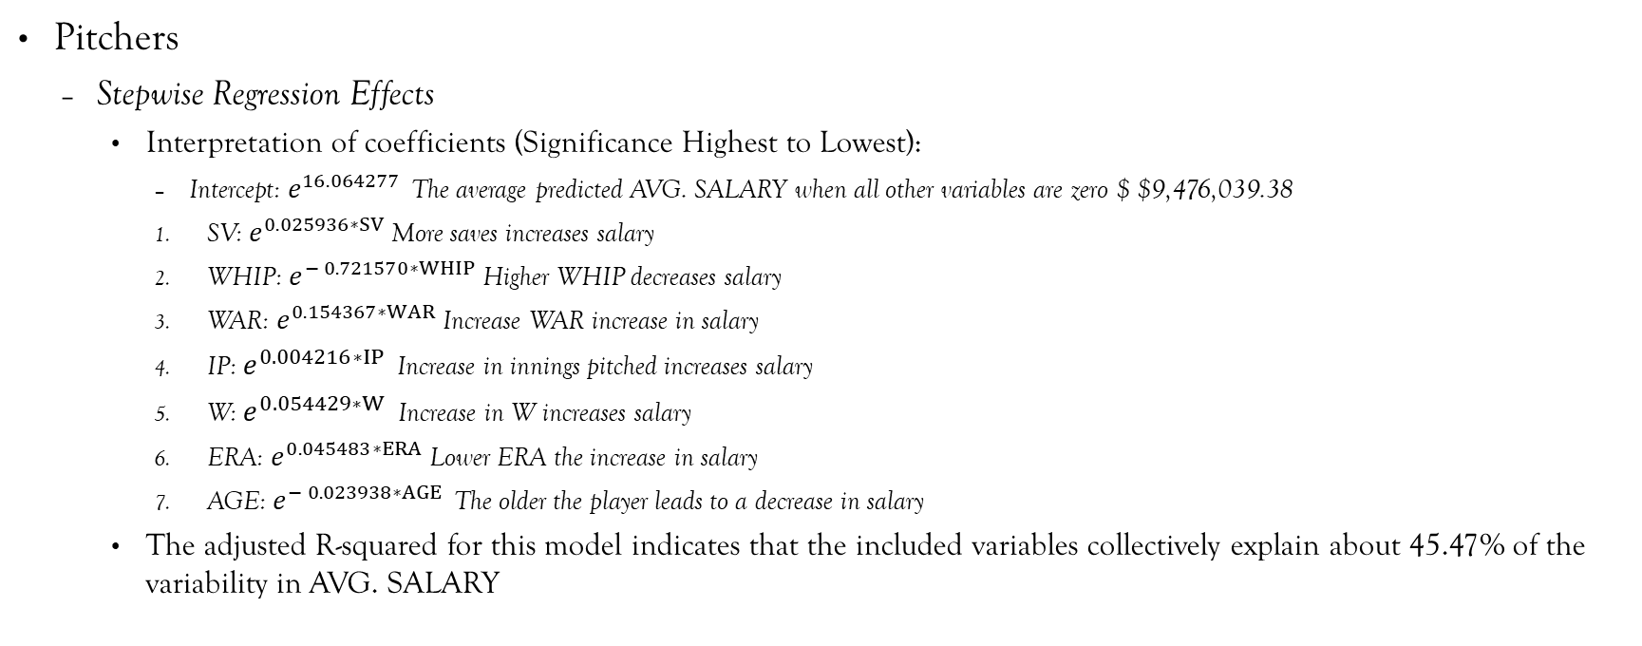
Results
Pitchers
Stepwise Regression Effects
Interpretation of coefficients (Significance Highest to Lowest):
Intercept: $e^{16.064277 }$The average predicted AVG. SALARY when all other variables are zero $ $9,476,039.38
SV: $e^{0.025936∗SV}$More saves increases salary
WHIP: $e^{− 0.721570∗WHIP}$Higher WHIP decreases salary
WAR: $e^{0.154367∗WAR}$Increase WAR increase in salary
IP: $e^{0.004216∗IP }$Increase in innings pitched increases salary
W: $e^{0.054429∗W }$Increase in W increases salary
ERA: $e^{0.045483∗ERA}$Lower ERA the increase in salary
AGE: $e^{− 0.023938∗AGE }$The older the player leads to a decrease in salary
The adjusted R-squared for this model indicates that the included variables collectively explain about 45.47% of the variability in AVG. SALARY

Slide 15
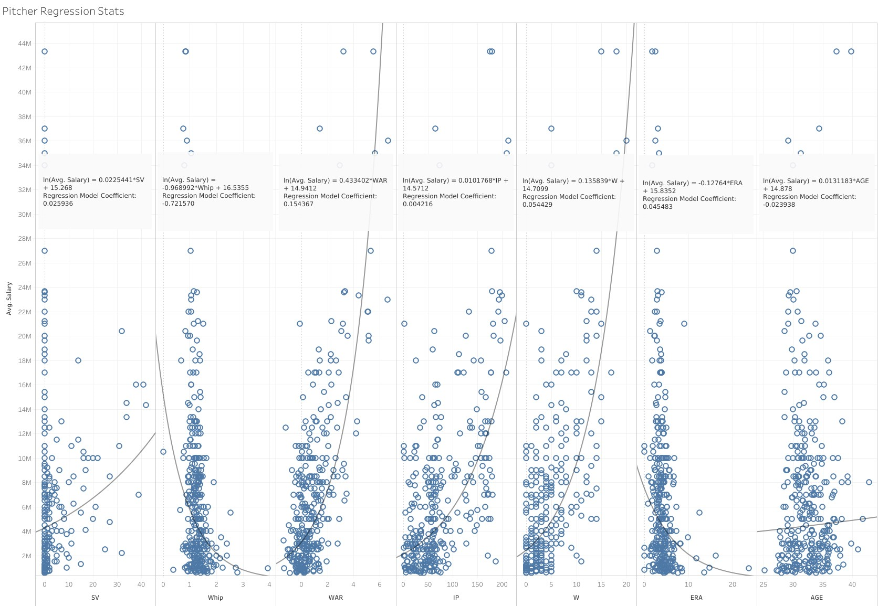

Slide 16
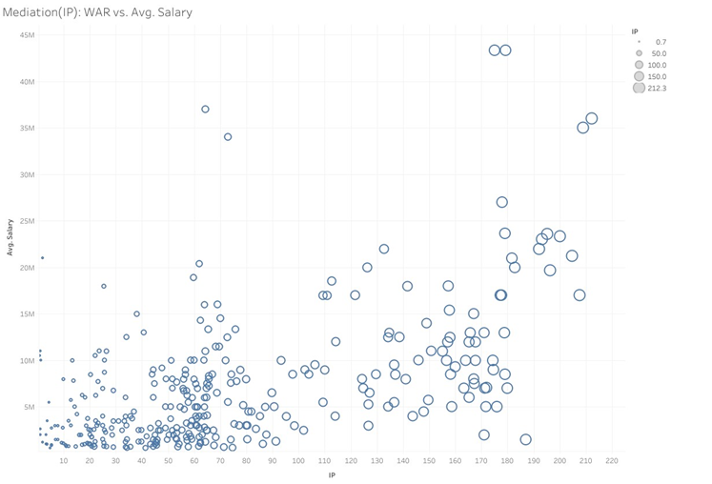
Mediation Analysis IP
IP
Indirectly effects 36.9% WAR on Salary

Slide 17
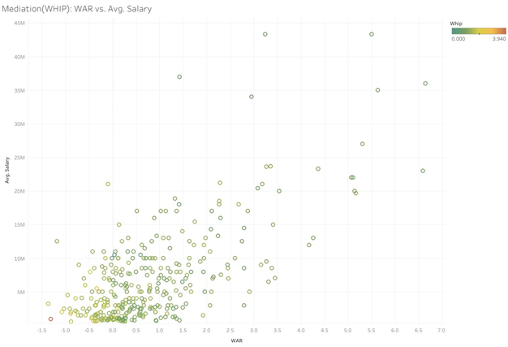
Mediation Analysis WHIP
WHIP - 9.204%

Slide 18
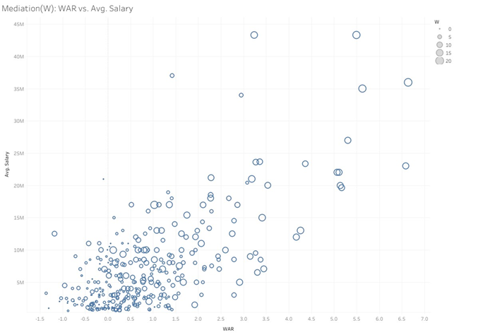
Mediation Analysis W
W - 45.2%

Slide 19
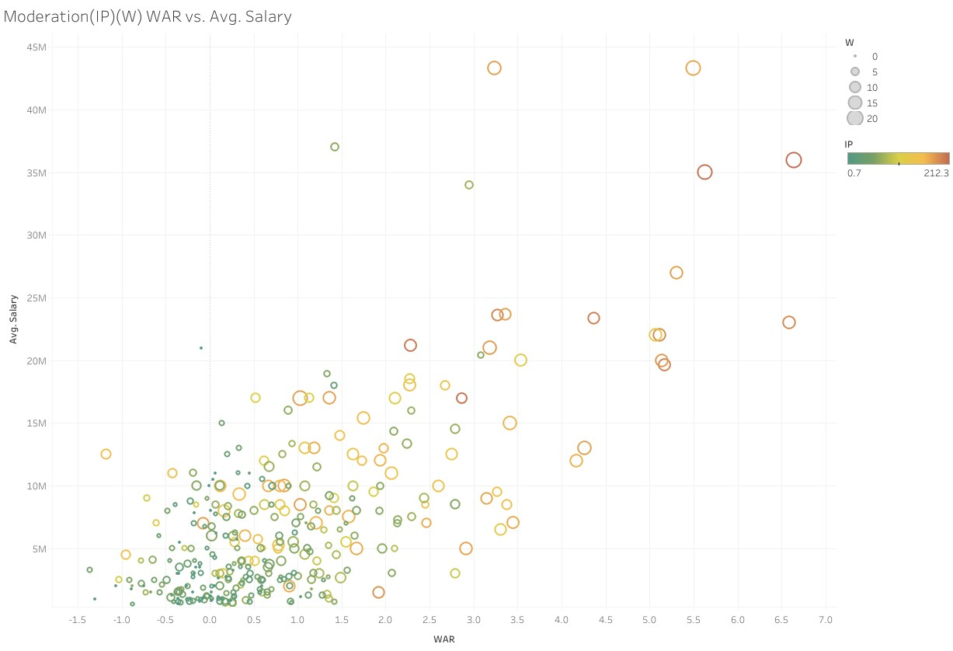
Moderation Analysis
IP
Coefficient: -0.0012974
Influences 39.66% on WAR and Salary
W
Coefficient: -0.01393
Influences 40.07% on WAR and Salary

Slide 20
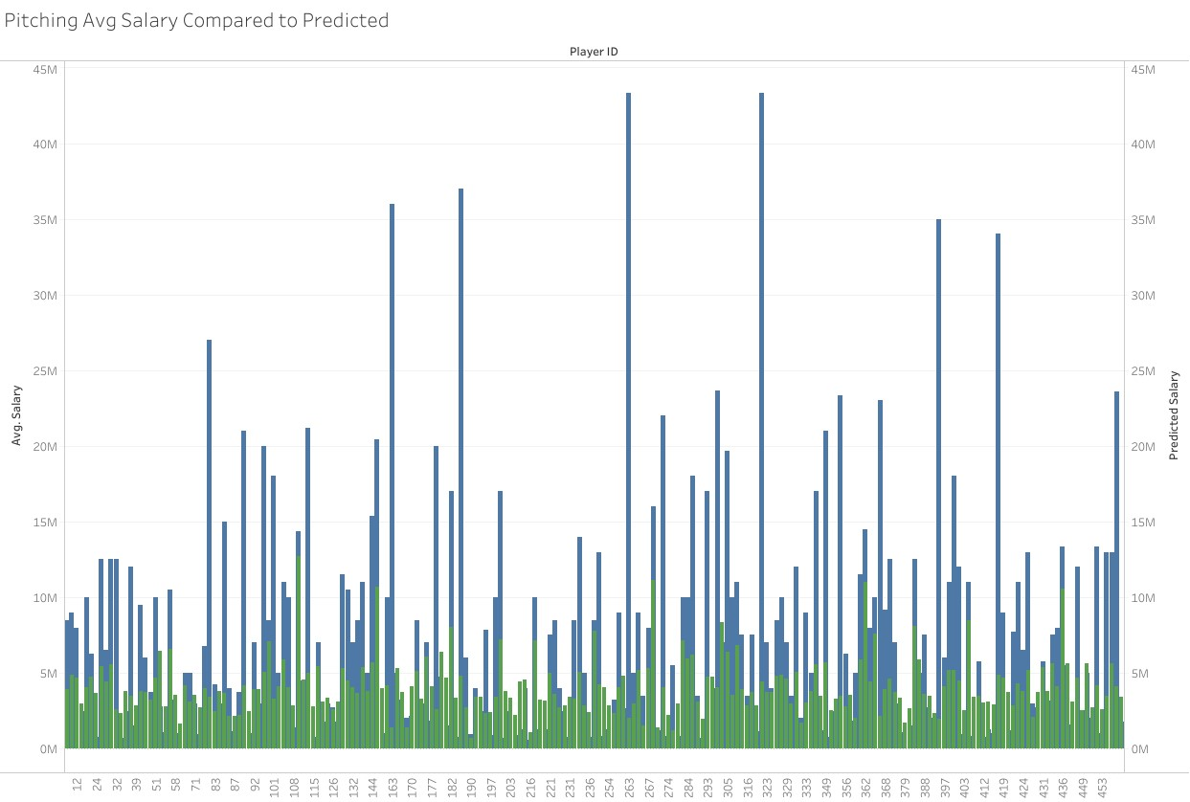
Comparison
$$Predicted Salary=e^{(16.064277 + 0.154367∗WAR − 0.023938∗AGE + 0.004216∗IP + 0.045483∗ERA − 0.721570∗WHIP + 0.054429∗W + 0.025936∗SV − 0.0012974∗\left(WAR ∗ IP\right) − 0.01393∗\left(WAR ∗ W\right))}$$

Slide 21
Percent Difference
Percent Difference = ((Predicted - Observed)/Observed) *100%
Over the whole Pitching Dataset
Average = 13.44%
Standard Deviation = 1.051311

Slide 22
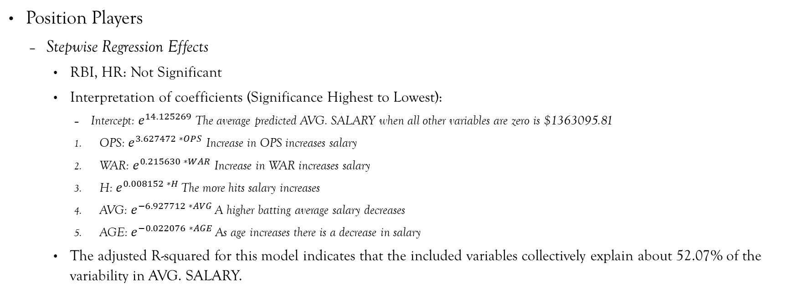
Results
Position Players
Stepwise Regression Effects
RBI, HR: Not Significant
Interpretation of coefficients (Significance Highest to Lowest):
Intercept: $e^{14.125269}$The average predicted AVG. SALARY when all other variables are zero is $1363095.81
OPS: $e^{3.627472 ∗OPS}$ Increase in OPS increases salary
WAR: $e^{0.215630 ∗WAR}$ Increase in WAR increases salary
H: $e^{0.008152 ∗H }$The more hits salary increases
AVG: $e^{−6.927712 ∗AVG }$A higher batting average salary decreases
AGE: $e^{−0.022076 ∗AGE }$As age increases there is a decrease in salary
The adjusted R-squared for this model indicates that the included variables collectively explain about 52.07% of the variability in AVG. SALARY.

Slide 23
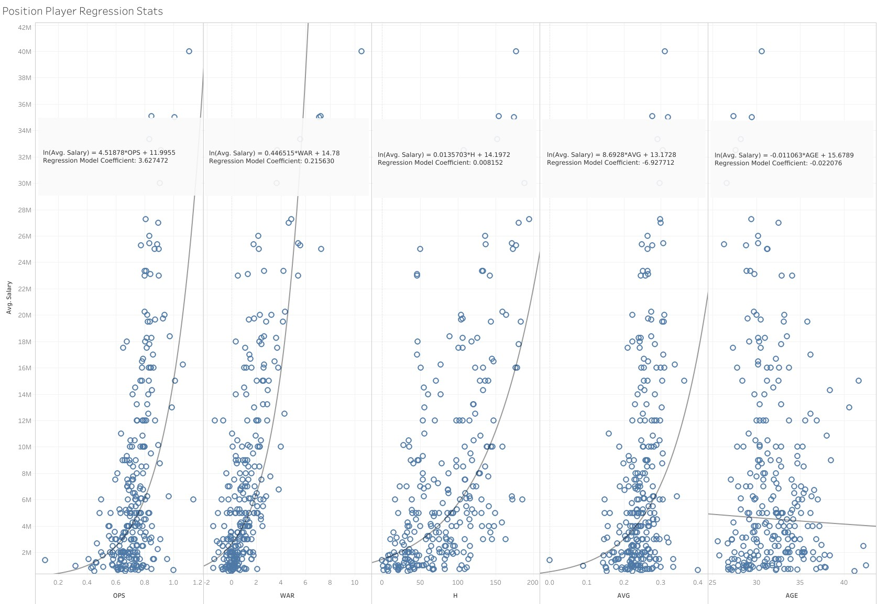

Slide 24
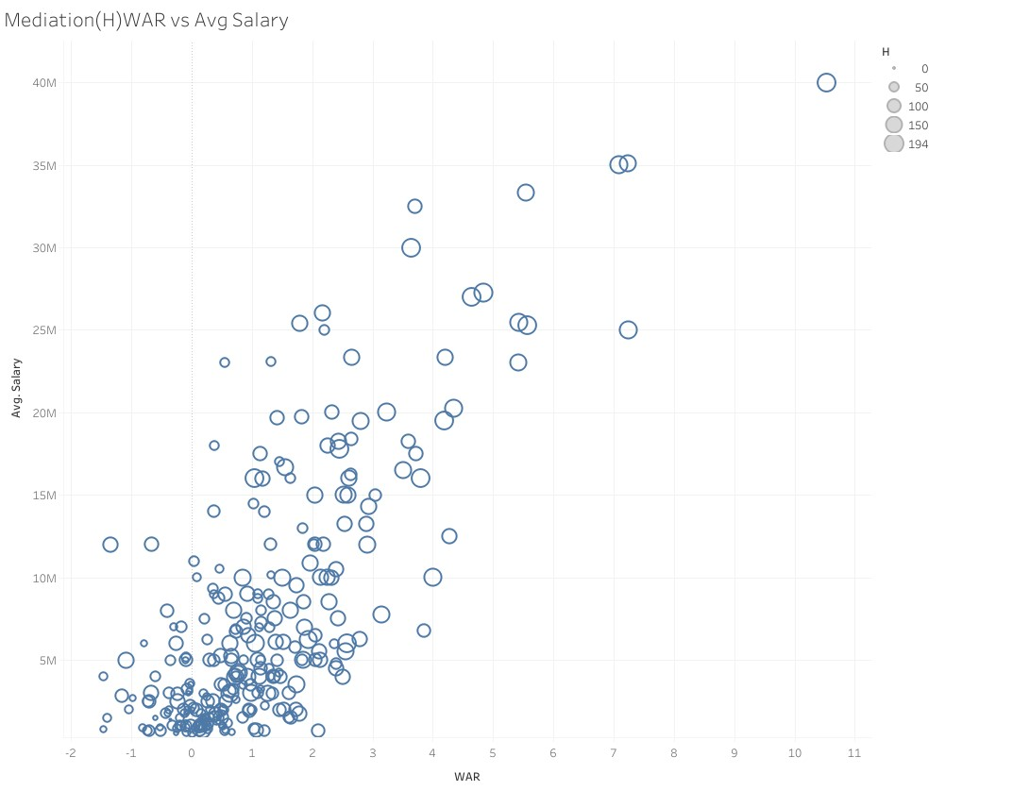
Mediation Analysis H
30.30%

Slide 25
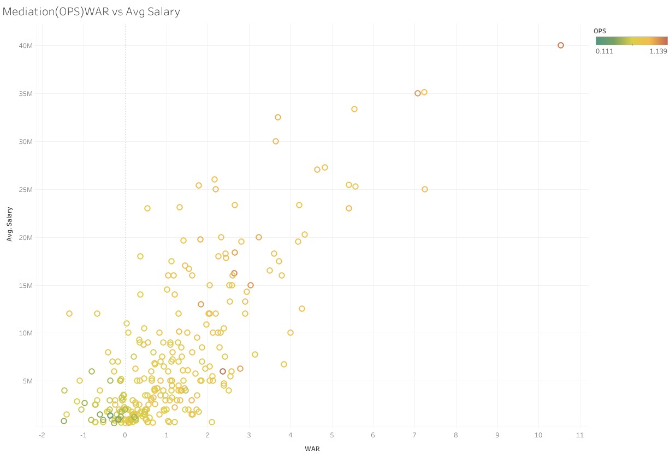
Mediation Analysis OPS
17.05%

Slide 26
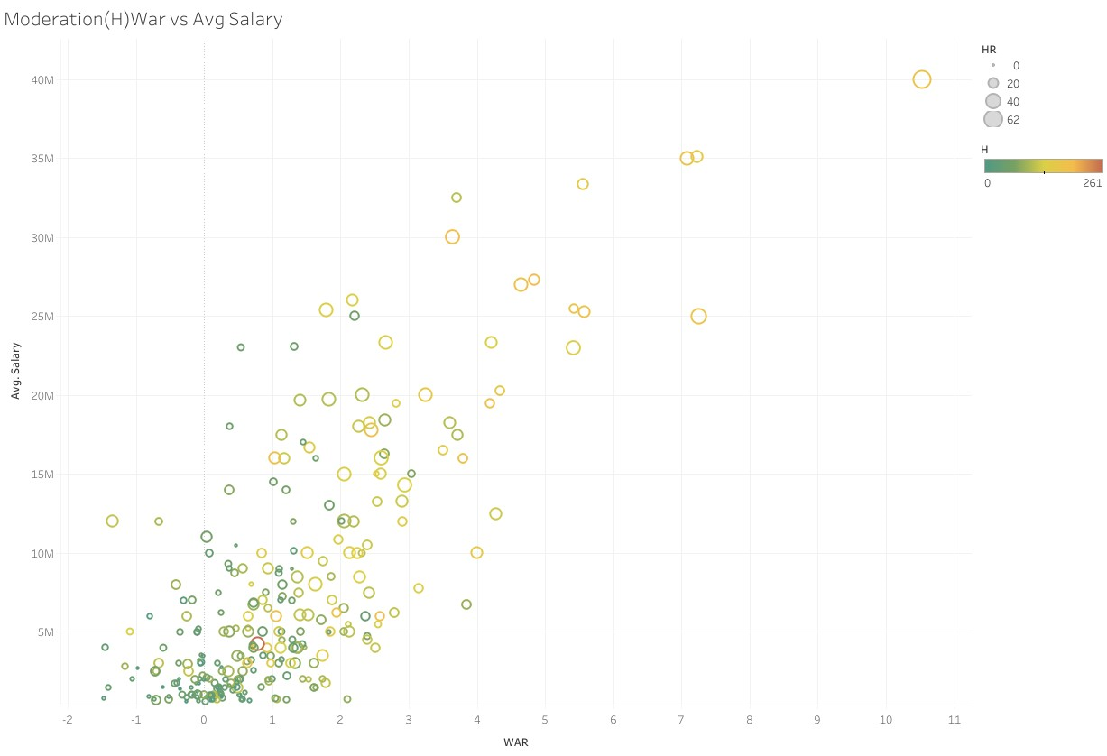
Moderation Analysis
H
Coefficient: -0.0018766
Influences 49.25% on WAR and Salary

Slide 27
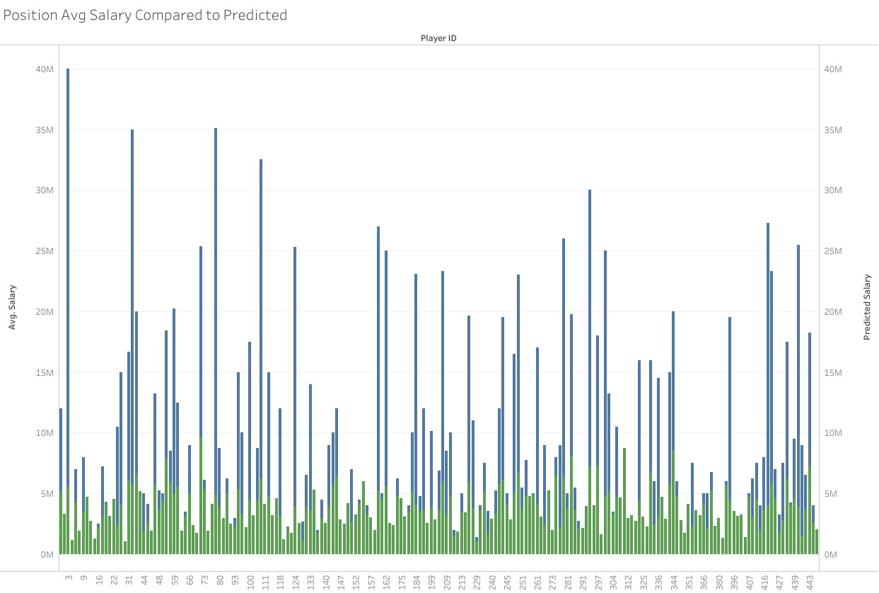
Comparison
$$Predicted Salary=e^{(14.125269 + 0.215630∗WAR − 0.022076∗AGE + 0.008152∗H − 6.927712∗AVG + 3.627472∗OPS − 0.0018766∗\left(WAR ∗ H\right))}$$

Slide 28
Percent Difference
Percent Difference = ((Predicted - Observed)/Observed) *100%
Over the whole Position Player Dataset
Average = 8.75%
Standard Deviation = .09736621

Slide 29
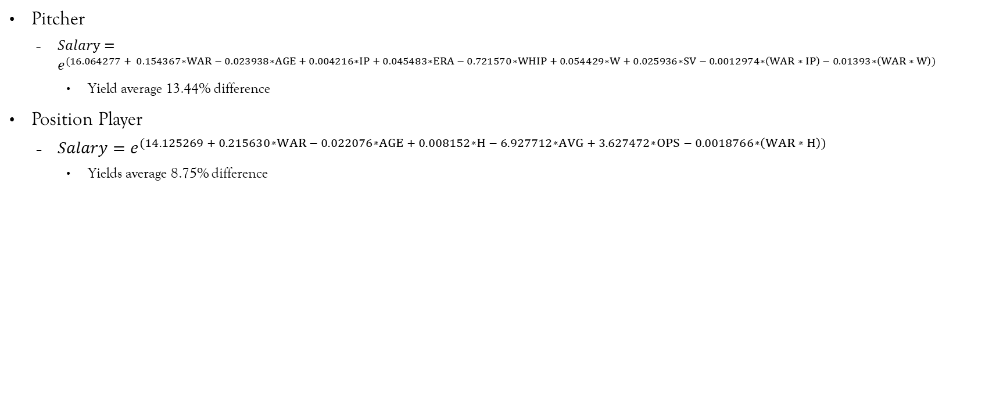
Summary
Pitcher
$Salary=e^{(16.064277 + 0.154367∗WAR − 0.023938∗AGE + 0.004216∗IP + 0.045483∗ERA − 0.721570∗WHIP + 0.054429∗W + 0.025936∗SV − 0.0012974∗\left(WAR ∗ IP\right) − 0.01393∗\left(WAR ∗ W\right))}$
Yield average 13.44% difference
Position Player
$Salary=e^{(14.125269 + 0.215630∗WAR − 0.022076∗AGE + 0.008152∗H − 6.927712∗AVG + 3.627472∗OPS − 0.0018766∗\left(WAR ∗ H\right))}$
Yields average 8.75% difference

Slide 30
Conclusions
Given the Average Percentage Error
Fine tuning is required(adding other statistic variables, changing regression model, etc.)
Unknowns that can't be account for such as Human Factor(Agent Negotiations
Still great for a front office to use just to get an idea if they are in or out on a player

Slide 31
Questions?

Slide 32
Citations
2024 MLB Free Agents Tracker. (n.d.). Spotrac.com. https://www.spotrac.com/mlb/free-agents/
Standard Stats | Glossary | MLB.com. (n.d.). MLB.com. https://www.mlb.com/glossary/standard-stats
Advanced Stats | Glossary | MLB.com. (n.d.). MLB.com. https://www.mlb.com/glossary/advanced-stats
Ravelo, C. (2022, November 23). Stepwise Regression: What is it and should you use it? Statistics Solutions. https://www.statisticssolutions.com/stepwise-regression-what-is-it-and-should-you-use-it/
Fein, E. C. (2022, June 16). Section 7.3: Moderation Models, Assumptions, Interpretation, and Write up. Pressbooks. https://usq.pressbooks.pub/statisticsforresearchstudents/chapter/moderation-assumptions/

